Slide 1

Quantitative Hydrologic Storylines
Joe Hamman¹, Julie Vano¹, Ethan Gutmann¹ ,Martyn Clark¹,
Jeff Arnold², Levi Brekke³, Ken Nowak³
NCAR Research Applications Lab
US Army Corps of Engineers Climate Resilience and Preparedness Program
Bureau of Reclamation Research and Development
Project Update Meeting, Reclamation, 17 October 2017

Slide 2
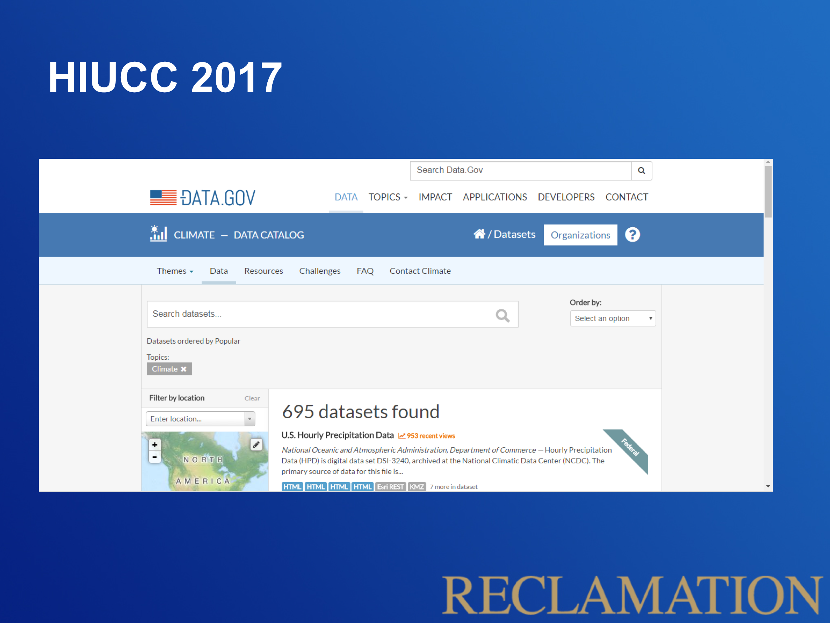
Motivation
The challenge is no longer finding information, it is navigating its proper use.
Slide from Ken Nowak

Slide 3
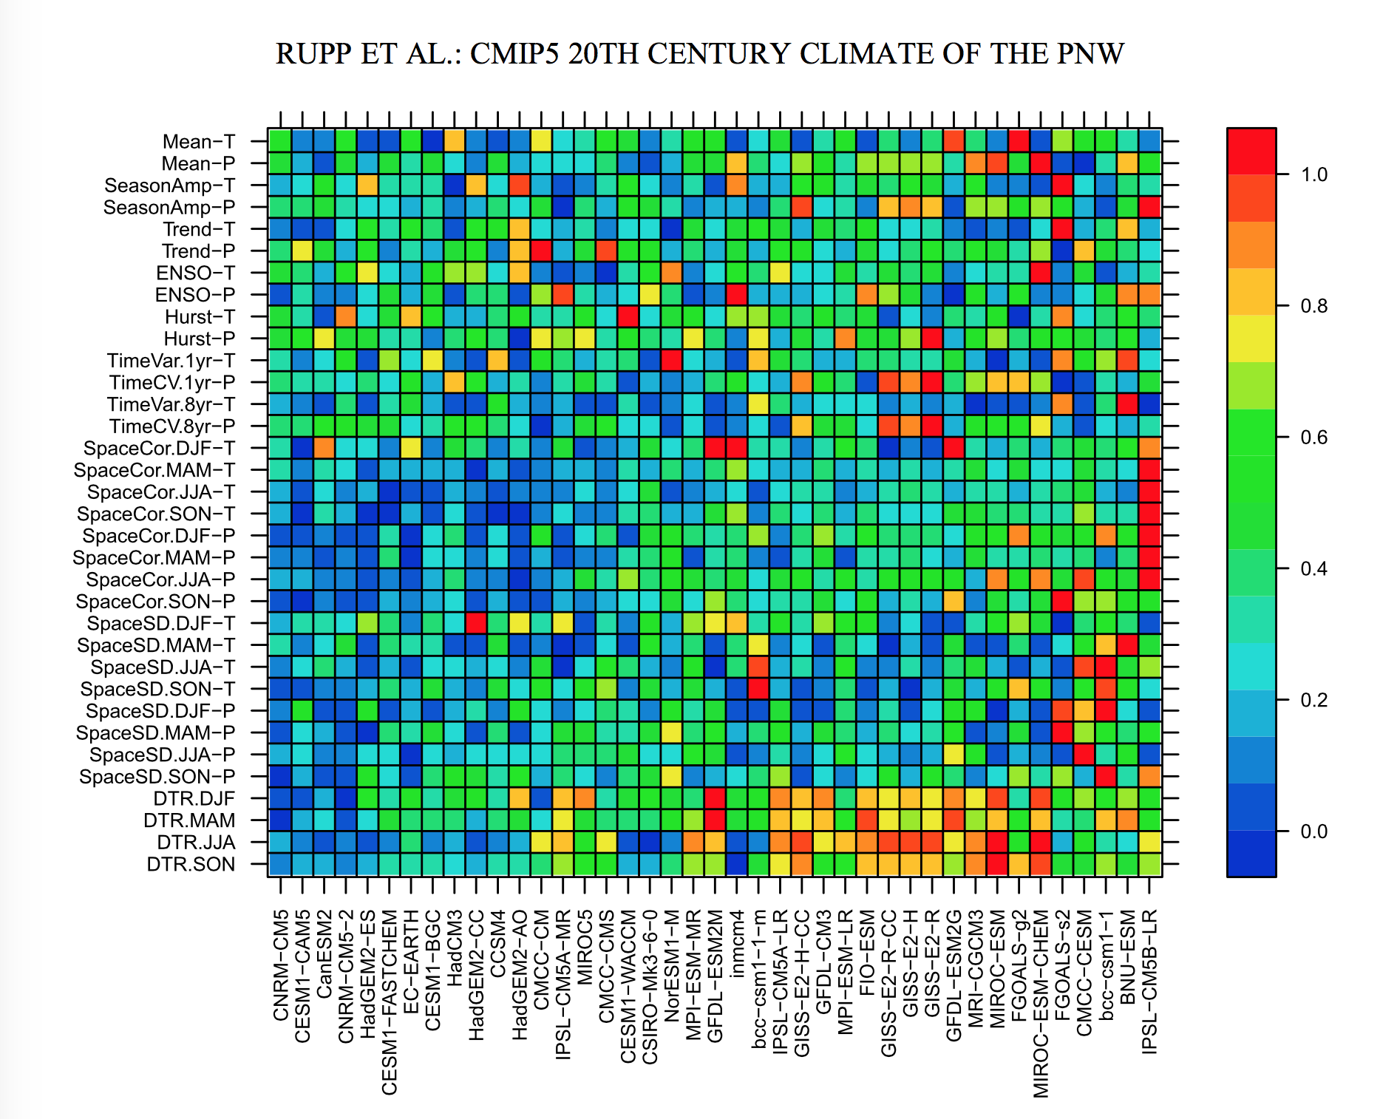
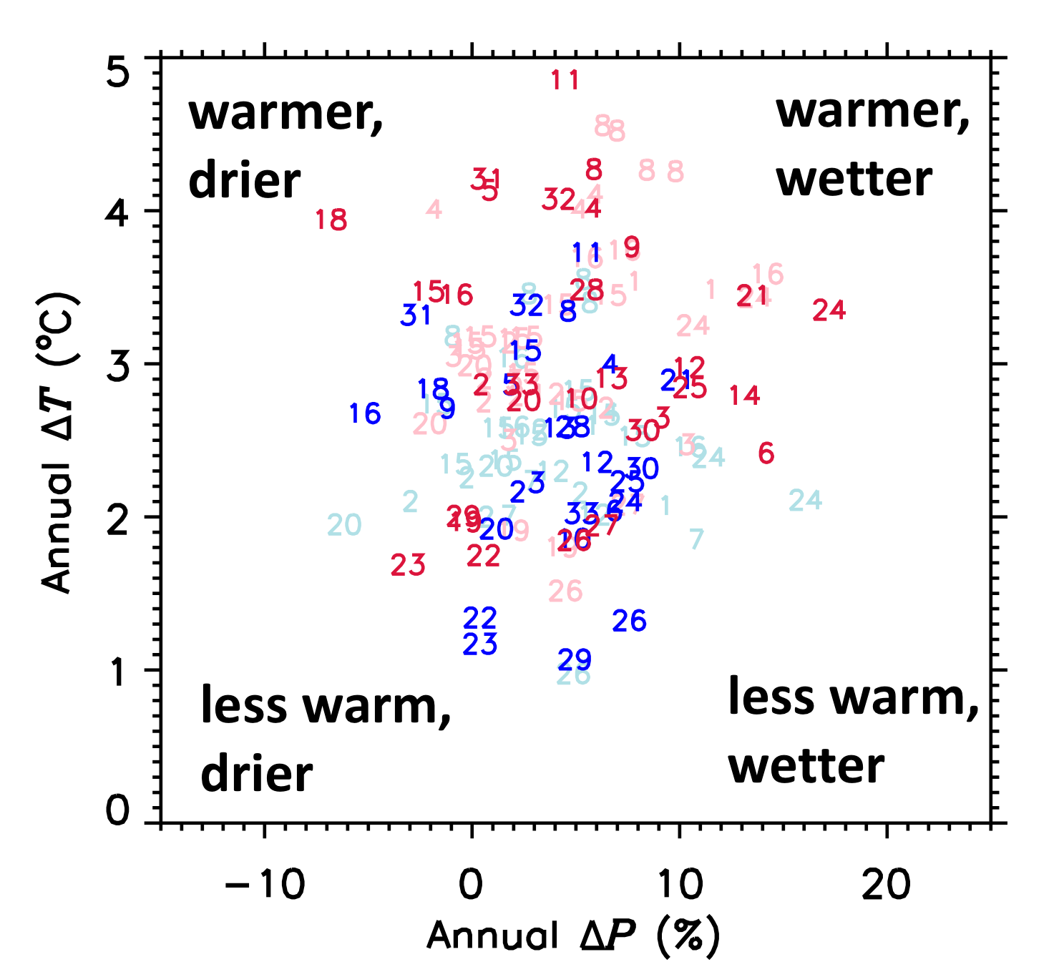
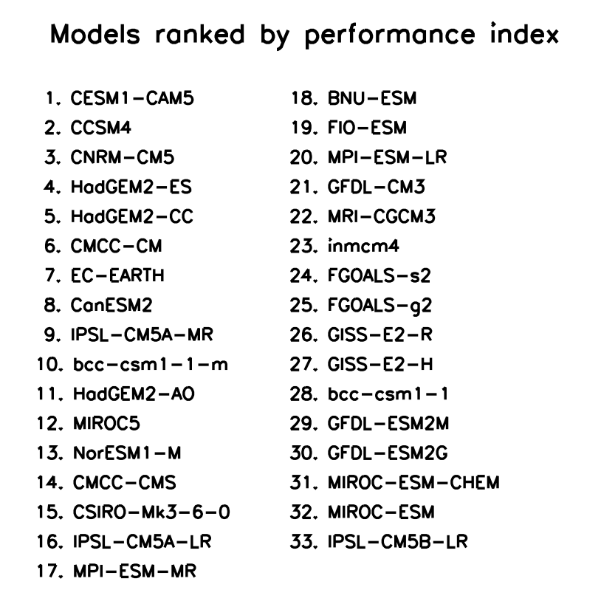
Motivation
Past attempts to navigate climate information
Use whatever runs are available
Select the first run of each global climate model
Rank models using historical performance metrics
Use models that span temperature-precipitation space
Note: global models focus
Notes:
From Rupp et al. Figure 2. Relative error of the ensemble mean of each metric for each CMIP5 GCM. Models are ordered from least (left) to most (right) total relative error, where total relative error is the sum of relative errors from all metrics.

Slide 4
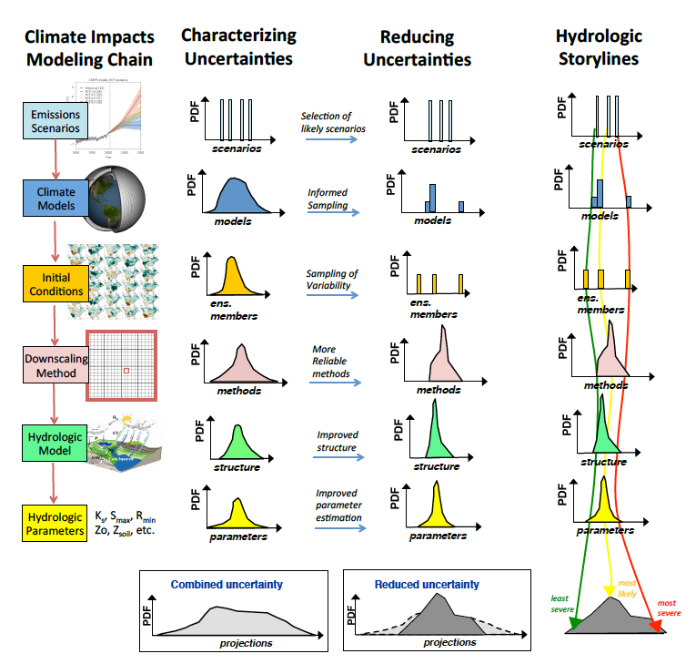
Navigating climate information

Slide 5
Navigating climate information
Developing infrastructure, methods, and models to characterize and reduce uncertainty
Developing the bridge for implementation in the water management community

Slide 6
Outline
Developing infrastructure, methods, and models to characterize and reduce uncertainty
Downscaling
Existing Methods
GARD and ICAR Ensemble
Initial Results
Sampling
Understanding Ensemble Structure (Clustering)
Tools for Parametric Ensemble Sampling
Next Steps
Hydrologic Modeling

Slide 7
Downscaling
Many existing climate downscaling techniques (e.g. BCSD, LOCA, SDSM, GARD, ICAR, WRF)
Gap in understanding how differences in downscaling techniques translate to differences in hydrologic projections
We’re building a large ensemble of downscaled datasets to test this
GARDx10+BCSD+LOCA+ICAR=13 DS techniques
2 RCPs and up to 32 GCMs (all CONUS+)
Scenario
GCMs
Downscaling methods

Slide 8
Downscaling
Characterizing Uncertainties
Uncertainty in hydrologic model forcings is the convolution of the downscaling modeling chain
Important to understand the sources of this uncertainty when choosing methods and developing sampling tools
The current ensemble is allowing us to explore uncertainty in hydrologic forcings

Slide 9
Downscaling
Spread in Mean Annual Precipitation Change (2080s – 1980s) for the Yakima (WA) and Upper Colorado (CO) basins.
Full Ensemble
GCMs
RCPs
Downscaling
Methods

Slide 10
Downscaling
Exploring the interactions of GCMs and Downscaling Methods
Change signals in temperature are consistent between models and downscaling methods
Precipitation signals are much less consistent, circulation based (methods) GARD tend to show robust drying
Figure: Heat map comparing change signals (2080s – 1980s) for mean annual temperature and precipitation over the Yakima River Basin.

Slide 11
Outline
Developing infrastructure, methods, and models to characterize and reduce uncertainty
Downscaling
Existing Methods
GARD and ICAR Ensemble
Initial Results
Sampling
Understanding Ensemble Structure (Clustering)
Tools for Parametric Ensemble Sampling
Next Steps
Hydrologic Modeling

Slide 12
Ensemble Sampling
Goals:
Represent uncertainly space
Avoid analyzing every possible ensemble combination
Select based on methodological fidelity
Approaches
Random sample or sample ensemble of convenience
Regional model performance
Global model performance

Slide 13
Ensemble Sampling
Exploring ensemble structure (how do combinations of methods differ?)
Optimal sampling: two examples
Regional performance
Global performance
Top 5 From CVDP
4
1
1
2
3
5
5
2
3
4
Top 5 From Rupp et al.
http://webext.cgd.ucar.edu/Multi-Case/CVDP_ex/CMIP5-Historical/metrics.html
Notes:
CVDP ranking
CMCC-CMS
HadGEM2-AO
NorESM1-ME
CCSM4
CESM1-BGC
HadGEM2-ES
CanESM2
CMCC-CM
CNRM-CM5
GISS-E2-R-CC
NorESM1-M
BNU-ESM
CESM1-CAM5-1-FV2
CESM1-CAM5
CESM1-FASTCHEM
HadGEM2-CC
IPSL-CM5A-LR
ACCESS1-0
ACCESS1-3
bcc-csm1-1-m
FIO-ESM
GISS-E2-H-CC
GISS-E2-R
IPSL-CM5A-MR
bcc-csm1-1
MRI-ESM1
CESM1-WACCM
FGOALS-g2
GFDL-CM2p1
GFDL-ESM2G
GFDL-ESM2M
IPSL-CM5B-LR
MIROC5
MPI-ESM-LR
GISS-E2-H
MRI-CGCM3
MIROC-ESM
MIROC-ESM-CHEM
CSIRO-Mk3-6-0
inmcm4

Slide 14
Outline
Developing infrastructure, methods, and models to characterize and reduce uncertainty
Downscaling
Existing Methods
GARD and ICAR Ensemble
Initial Results
Sampling
Understanding Ensemble Structure (Clustering)
Tools for Parametric Ensemble Sampling
Next Steps
Hydrologic Modeling

Slide 15
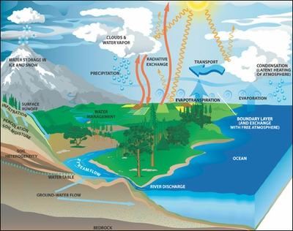
Hydrologic Modeling
Hydrologic models
FUSE, PRMS, and VIC
Status
VIC/PRMS have been run for BCSD with default and MPR params (VIC only)
FUSE has been run for BCSD with default parameters
Preparing inputs for GARD/LOCA/ICAR runs for all models
Figure from Nans Ador’s 2017 EGU poster

Slide 16
Navigating climate information
Developing infrastructure, methods, and models to characterize and reduce uncertainty
Developing the bridge for implementation in the water management community
Notes:
1. Using engagement with water management community to inform storylines selection
2. Making information about uncertainty more accessible, translatable, and engaging

Slide 17
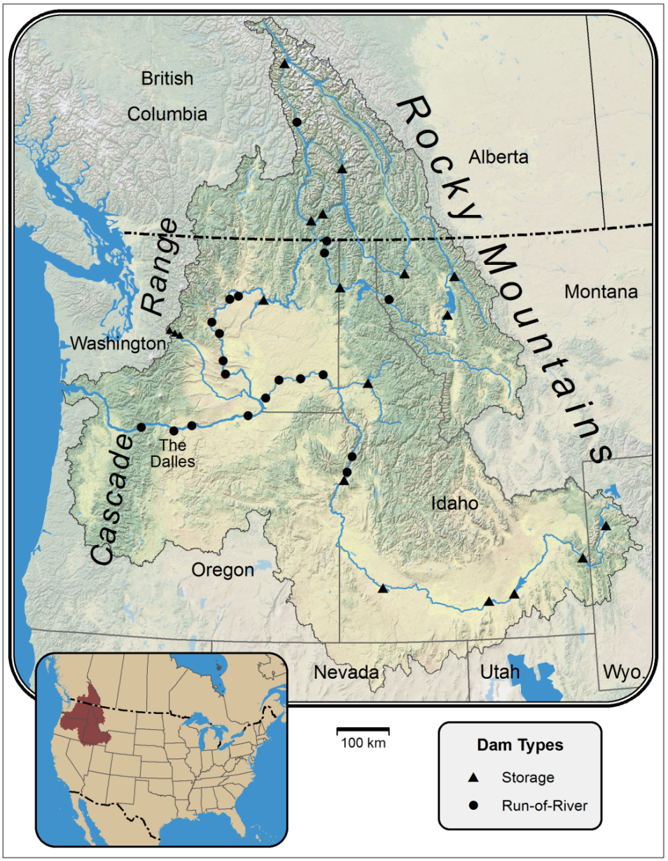
Demonstration project
Engagement to inform storylines
US Army Corps of Engineers Seattle and Walla Walla District Offices
Working with water managers to identify key decisions that climate change information can inform (currently ~10 metrics)
Real world context to explore how location or impact of interest can change model selection
Libby
Dworshak

Slide 18
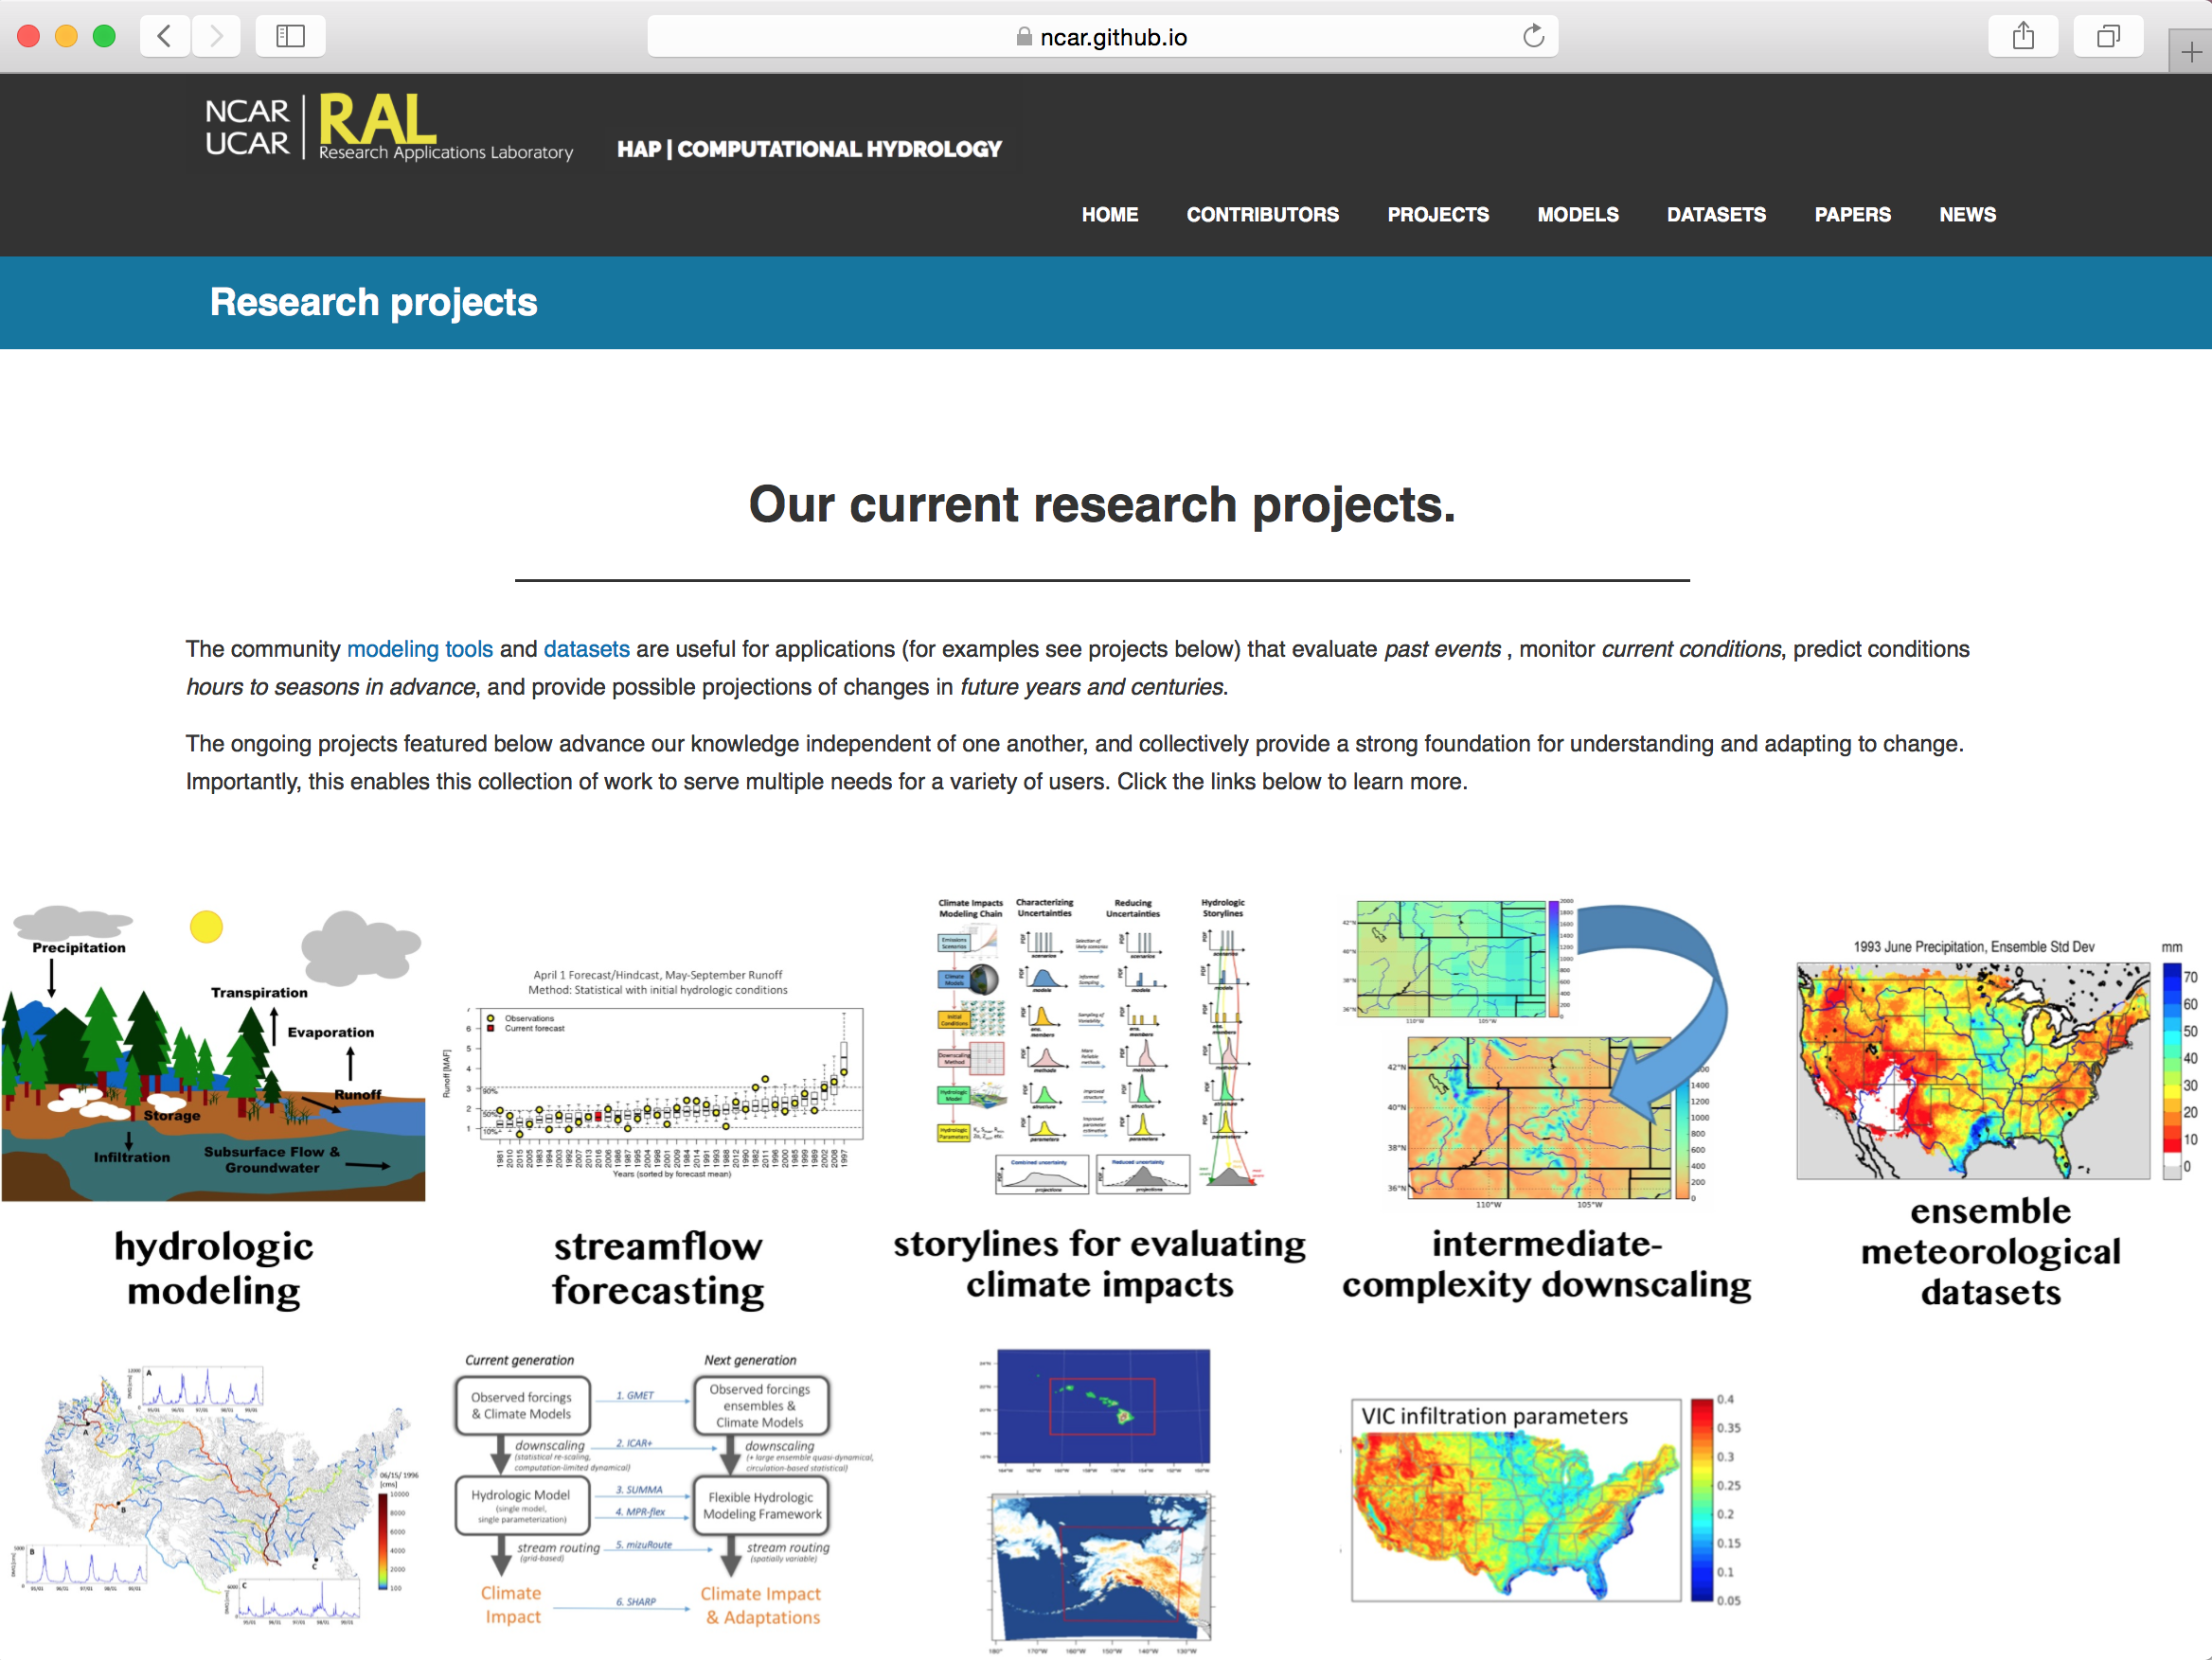
Accessible information
https://ral.ucar.edu/hap/computational-hydrology

Slide 19
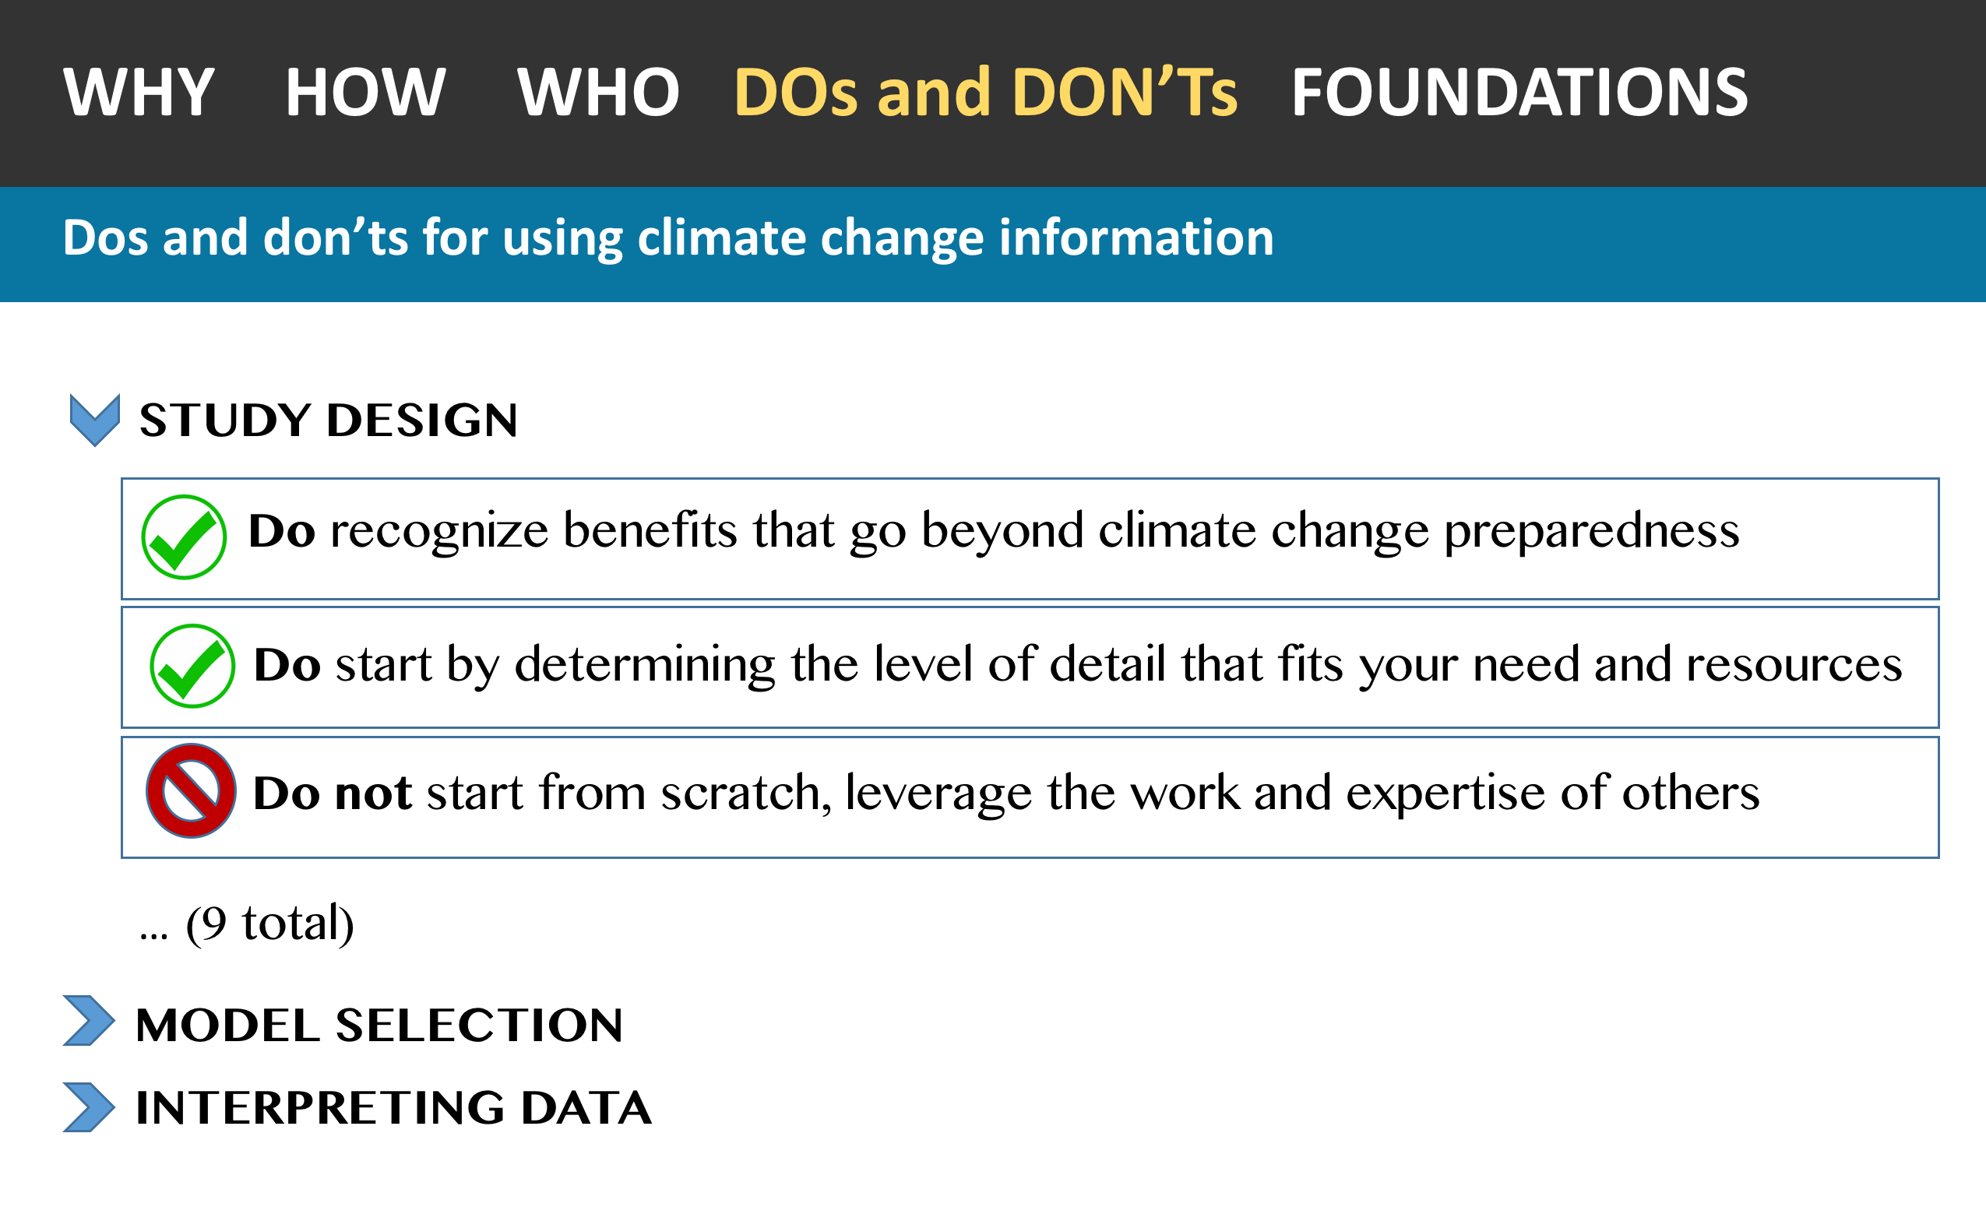
Dos and Don’ts for using climate change information in water planning and management
Guidelines
Builds on earlier guidance
Modular
Two-way information exchange
Updatable (github)
Version 1.0 in review
Website under construction
Timely, could inform several best practice efforts

Slide 20

How are people across Reclamation using climate information?
Proposal: Preparing for a Changing Climate: Understanding How Climate Information is Used in Planning and Decision Support across Reclamation (1815)
Project Team: Ian Ferguson, Julie Vano, Martyn Clark, Dan Broman, Subhrendu Gangopadhyay, Marketa McGuire, James Gilbert, Katharine Dahm
Different datasets ???
Different methods ???
Different tools ???
Broad survey across major Reclamation programs, initiatives, and activities, coupled with an in-depth analysis of the Basin Study Program
Figure from Reclamation report on Conveying Climate Change and Vulnerability

Slide 21
Additional slides…

Slide 22
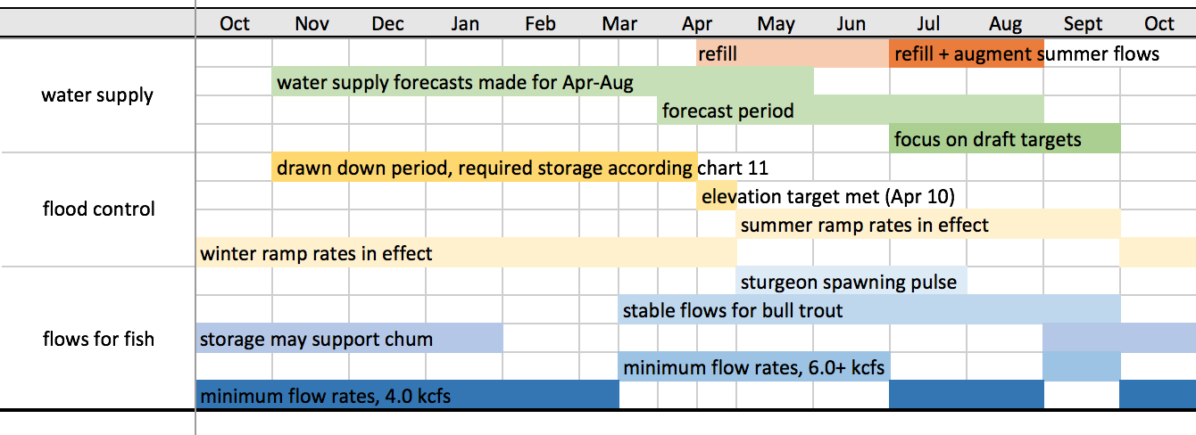
Managers provide
Better understanding management decisions can help inform model selection in many ways, including…
Planning horizon
Number of scenarios
Metrics: help select better performing models/techniques
Metrics: some metrics more sensitive to variations in models, parameters
Change thresholds
Ensemble outcomes of interest

